Slide 1
Time Oriented Data Visualization
Prof. Ramesh Ragala
VIT University
Chennai

Slide 2
Visualization Techniques for Time-Oriented Data
Time is an inherent data dimension
It identifies the patterns and relationships in the data
It reveals the trends
Time oriented data uses in scientific publications
Time and Time-Oriented data has distinct characteristics → separate data type
If we observes the particular characteristics of time can significantly improve the expressiveness of visual representations.
chose a visual representation that fits the data characteristics like cycle,..
Parameterize the visual representation accordingly in a state to identify the hidden patterns in data.

Slide 3
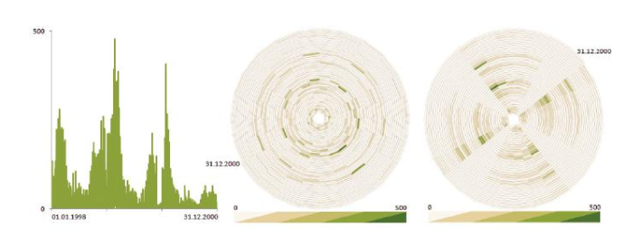
Visualization Techniques for Time-Oriented Data
Visual Representation of time-oriented dataset
Data set description:
The daily number of cases of influenza that occurred in the northern part of Germany during a period of three years

Slide 4
Visualization Techniques for Time-Oriented Data
Visual Representation of time-oriented dataset
The Left-most image uses simple line-plot to visualize the data
The peaks has some significance with respect to time
The cyclic behaviour of the data can be guessed.
But unable to identify the cyclic temporal pattern in the data
The middle and Right images shows the circular representation using spiral-shaped time axis.
The cyclic pattern is not visible in the middle images, because the cycle length has been set to 24 days → which does not match the pattern in data.
The Right image uses cycle length as 28 days. → reveals the periodic pattern in the data. ### able to see the weekly pattern if the cycle length is 7 or 14

Slide 5
Visualization Techniques for Time-Oriented Data
It is important to make a clear distinction between the physical dimension time and a model of time in information systems
Modelling the time in information system
Imitate the physical dimension time
To provide a model that is best suited to reflect the phenomena
Support the analysis task
There are many ways to model the time in information systems
The time in information system can be modelled differently for different application based on the particular problem.
Notion of time in many areas like AI, data mining, simulation, modelling, databases etc.

Slide 6
Visualization Techniques for Time-Oriented Data
Characteristics of Time: general aspects Vs hierarchical Vs Concrete
The general aspects of time are scale, scope, arrangement and viewpoints
Scale:
Ordinal time domain: Relative order relation
Example: before, after, during
Discrete time domain: Temporal distance can also be considered
Time values can be mapped to a set of integers.
Discrete time domains are based on a smallest possible unit (second, minutes)
Continuous time domain: mapping to real numbers, between any two points in time
Simply called as Dense time

Slide 7
Visualization Techniques for Time-Oriented Data
Characteristics of Time:
The general aspects of time are scale, scope, arrangement and viewpoints
Scope: scope of the basic element that constitute of the time domain
Point-based time domain:
It is similar to discrete Euclidean points in space, i.e having temporal extent to zero
Thus, no information is given about the region between two points in time
Example:
The time value May 1, 2014 might relate to the single instant May 1, 2014 00:00:00
Interval-based time domain:
It is having a temporal extent greater than zero
This aspect is also closely related to the notion of granularity
Example:
time value May 1, 2014 might relate to the interval [May 1, 2014 00:00:00, May 1, 2014 23:59:99]s

Slide 8
Visualization Techniques for Time-Oriented Data
Characteristics of Time:
The general aspects of time are scale, scope, arrangement and viewpoints
Arrangement: The arrangement of time domain
Linear Organization:
we mostly consider time as proceeding linearly from the past to the future i.e, each time value has a unique predecessor and successor.
Cyclic Organization:
The time domain is composed of a set of recurring time values i.e, the seasons of the year
Hence, any time value A is preceded and succeeded at the same time by any other time value B.
Example:
winter comes before summer, but winter also succeeds summer

Slide 9
Visualization Techniques for Time-Oriented Data
Characteristics of Time:
The general aspects of time are scale, scope, arrangement and viewpoints
Viewpoint: Views of time, that are modelled
Ordered time domain:
The things that are happen one after the other
In totally ordered domain, only one thing can happen at a time.
In Partially ordered domain, simultaneous or overlapping events are allowed at a time
Branching time domain:
Complex form of time-domain
Here, multiple strands of time branch out and allow the description and comparison of alternative scenarios ### only one path through time will actually happen
Example:
Project Planning, i.e Grantt chart
Multiple perceptive time domain:
In multiple perspectives facilitate simultaneous (even contrary) views of time
Example
eyewitness reports that describe the same situation, each of which being slightly different

Slide 10
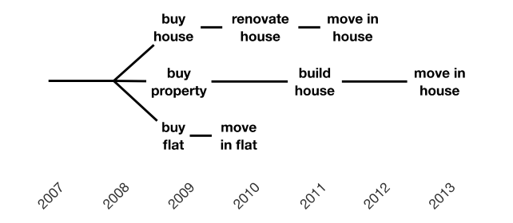
Visualization Techniques for Time-Oriented Data
Characteristics of Time:
The general aspects of time are scale, scope, arrangement and viewpoints
Viewpoint: Views of time, that are modelled

Slide 11
Visualization Techniques for Time-Oriented Data
Characteristics of Time:
The hierarchical organization of time and concrete time elements is determined based on granularity, time primitives, and determinacy.
Granularity and Calendar: none Vs single Vs multiple
Basically, granularity can be thought of as a (human-made) abstraction of time in order to make it easier to deal with time in everyday life (such as minutes, hours, days, weeks, months)
To tackle the complexity of time and to provide different levels of granularity useful abstractions can be employed
More generally, granularity describes mappings from time values to larger or smaller conceptual units.
Multiple Granularity: iff granularity and calendar system is supported by the time model
Single granularity: Every time value is given in terms of milliseconds
None granularity: None of the abstractions are supported

Slide 12
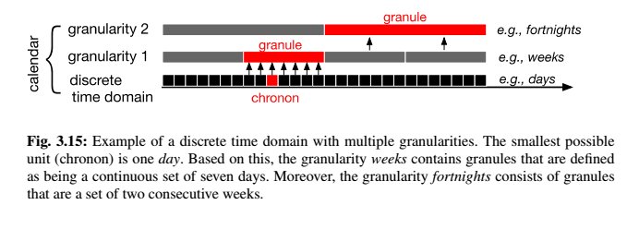
Visualization Techniques for Time-Oriented Data
Characteristics of Time:
The hierarchical organization of time and concrete time elements is determined based on granularity, time primitives, and determinacy.
Granularity and Calendar: none Vs single Vs multiple

Slide 13
Visualization Techniques for Time-Oriented Data
Characteristics of Time:
The hierarchical organization of time and concrete time elements is determined based on granularity, time primitives, and determinacy.
Time primitives: Instant Vs Internal Vs Span
These time primitives can be seen as an intermediary layer between data elements and the time domain.
Time primitives can be divided into anchored (absolute) and unanchored (relative) primitives
Instant and interval are primitives that belong to absolute primitives
These are located on a fixed position along the time domain
Instants are a model for single points in time.
intervals range between two points in time.
a span is a relative primitive
it has no absolute position in time
spans are durations without a fixed position

Slide 14
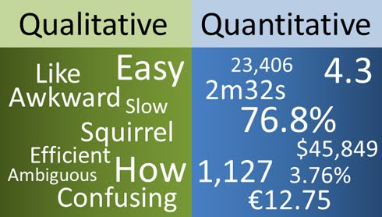
Visualization Techniques for Time-Oriented Data
Characteristics of Time-Oriented Data:
These primary categories form a basis for finding an expressive, appropriate, and effective visualization technique for time-oriented data
Scale: quantitative Vs qualitative
Quantitative data are based on a metric scale (Discrete or Continuous)
Qualitative data describe either unordered (nominal) or ordered (ordinal) sets of data elements

Slide 15
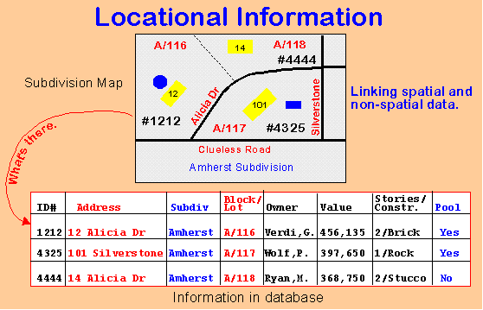
Visualization Techniques for Time-Oriented Data
Characteristics of Time-Oriented Data:
Frame of Reference: abstract Vs spatial
Abstract data (e.g., a bank account) have been collected in a non-spatial context
Spatial data (e.g., census data) contain an inherent spatial layout, e.g., geographical positions.

Slide 16
Visualization Techniques for Time-Oriented Data
Characteristics of Time-Oriented Data:
Kind of Data: events Vs states
Events can be seen as markers of state changes example: result out
States can be characterize the phases of continuity between the events

Slide 17
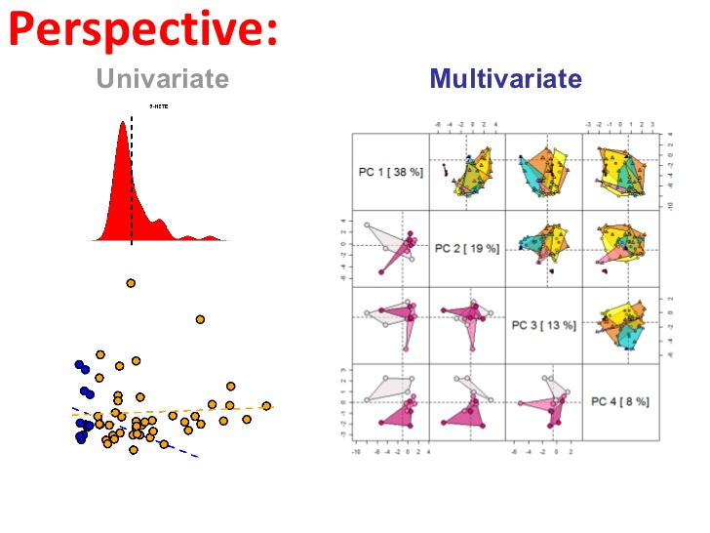
Visualization Techniques for Time-Oriented Data
Characteristics of Time-Oriented Data:
Number of Variables: univariate Vs multivariate
Univariate data contain only one data value per temporal primitive
multivariate data each temporal primitive holds multiple data values

Slide 18
Visualization Techniques for Time-Oriented Data
Relating Data and Time:
Time dependency of data have been extensively examined in the field of temporal databases
Two temporal domain of datasets are: 1. Internal Time 2. External Time
Internal time:
It is a temporal dimension inherent in the data model.
Internal time describes when the information contained in the data is valid.
External time:
It is an extrinsic to the data model.
The external time is necessary to describe how a data set evolves in (external) time.

Slide 19
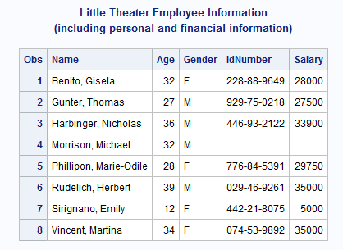
Visualization Techniques for Time-Oriented Data
Relating Data and Time:
Time – related data sets can be classified based on internal and external time primitives
Static Non-temporal Data:
If both internal and external time are each comprised of only one temporal element, the data are completely independent of time.
A fact sheet containing the data about the products
Offered by company

Slide 20
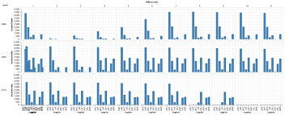
Visualization Techniques for Time-Oriented Data
Relating Data and Time:
Time – related data sets can be classified based on internal and external time primitives
Static temporal Data:
If the internal time contains more than one time primitive, while the external time contains only one, then the data can be considered dependent on time.
Common time-series are a prominent example of static temporal data.

Slide 21
Visualization Techniques for Time-Oriented Data
Relating Data and Time:
Time – related data sets can be classified based on internal and external time primitives
Dynamic Non - temporal Data:
If the internal time contains only one, but the external time is composed of multiple time primitives, then the data depend on the external time.
The data change over time, i.e., they are dynamic.
The historical view of the data is not maintained.

Slide 22
Visualization Techniques for Time-Oriented Data
Relating Data and Time:
Time – related data sets can be classified based on internal and external time primitives
Dynamic temporal Data:
If both internal and external time are comprised of multiple time primitives, then the data are considered to be bi-temporally dependent
the data contain variables depending on (internal) time, and the actual state of the data changes over (external) time.

Slide 23
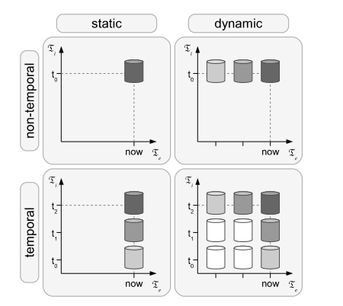
Visualization Techniques for Time-Oriented Data
Relating Data and Time:
Time – related data sets can be classified based on internal and external time primitives

Slide 24
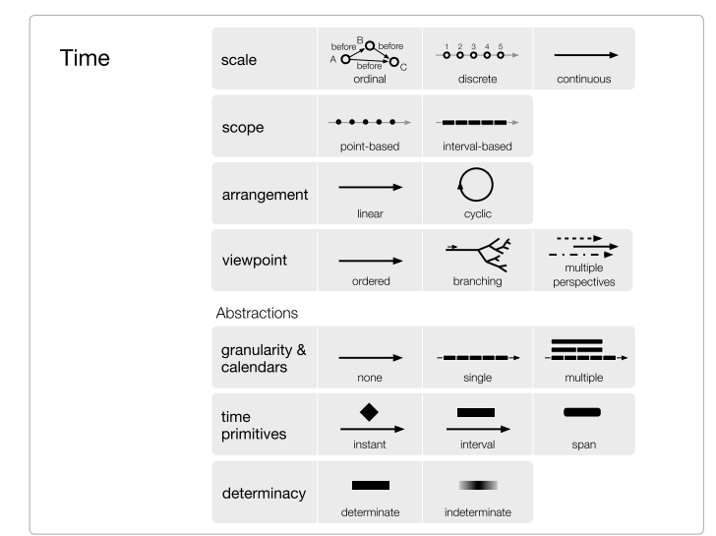
Visualization Techniques for Time-Oriented Data
Relating Data and Time:

Slide 25
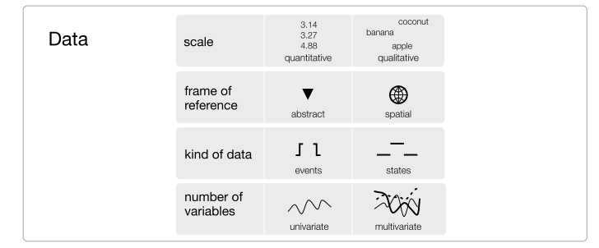
Visualization Techniques for Time-Oriented Data
Relating Data and Time:

Slide 26
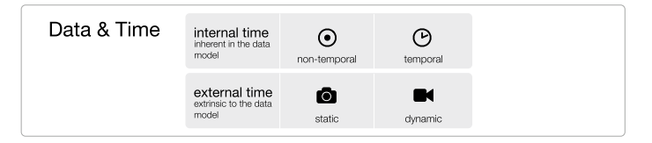
Visualization Techniques for Time-Oriented Data
Relating Data and Time:

Slide 27
Visualization Techniques for Time-Oriented Data
Visualizing Time-Oriented Data :
Point Plot:
One of the most straight forward way to depicting time-series data using Cartesian coordinating system.
A point is plotted for every measured time-value pair.
Some times it is also called as point graph, scatter plot.
Example in class

Slide 28
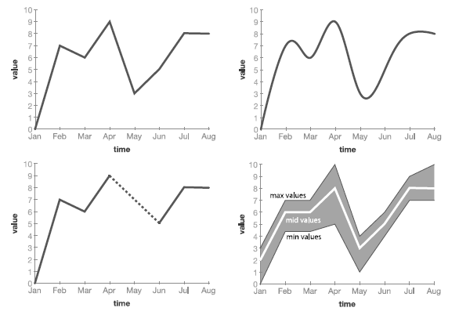
Visualization Techniques for Time-Oriented Data
Visualizing Time-Oriented Data :
Line Plot:
They extend point plots by linking the data points with lines which emphasizes their temporal relation. → approximation only
line plots focus on the overall shape of data over time.
This is in contrast to point plots where individual data points are emphasized
There are different styles of connections between the data points such as straight lines, step lines, Bezier curves, etc based on phenomena.
Example in class

Slide 29
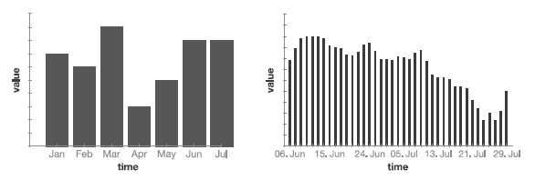
Visualization Techniques for Time-Oriented Data
Visualizing Time-Oriented Data :
Bar Graphs and Spike Graph:
bars are used to depict data values
This makes comparisons easier than with point plots.
As bar length is used to depict data values, only variables with a ratio scale (having a natural zero) can be represented.
A variant of bar graphs often used for graphing larger time-series (e.g., stock market data such as price or volume) are spike graphs.

Slide 30
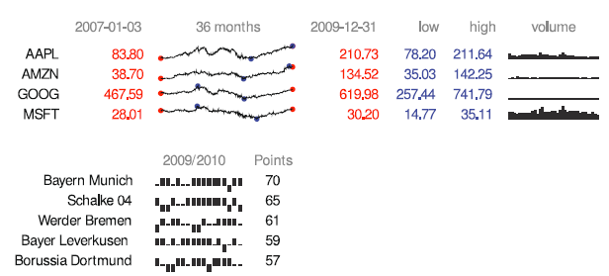
Visualization Techniques for Time-Oriented Data
Visualizing Time-Oriented Data :
sparklines :
Sparklines are simple, word-like graphics intended to be integrated into text.
This makes comparisons easier than with point plots.
The visualization method focuses mainly on giving an overview of the development of values for time-oriented data rather than on specific values or dates due to their small size and the omission of axes and labels.

Slide 31
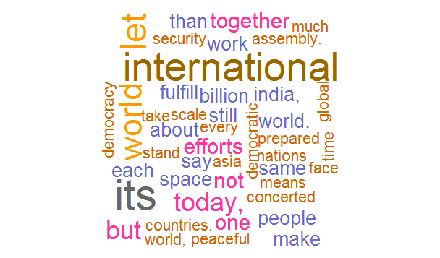
Visualization Techniques for Time-Oriented Data
Visualizing Time-Oriented Data :
SparkClouds :
Tag clouds visualize a set of keywords weighted by their importance.
By varying font size, color, or other visual variables important keywords are emphasized over less-important keywords
The visualization method focuses mainly on giving an overview of the development of values for time-oriented data rather than on specific values or dates due to their small size and the omission of axes and labels.

Slide 32
Visualization Techniques for Time-Oriented Data
Visualizing Time-Oriented Data :
Horizon Graph :
Tag clouds visualize a set of keywords weighted by their importance.
By varying font size, color, or other visual variables important keywords are emphasized over less-important keywords
The visualization method focuses mainly on giving an overview of the development of values for time-oriented data rather than on specific values or dates due to their small size and the omission of axes and labels.

